Slide 1
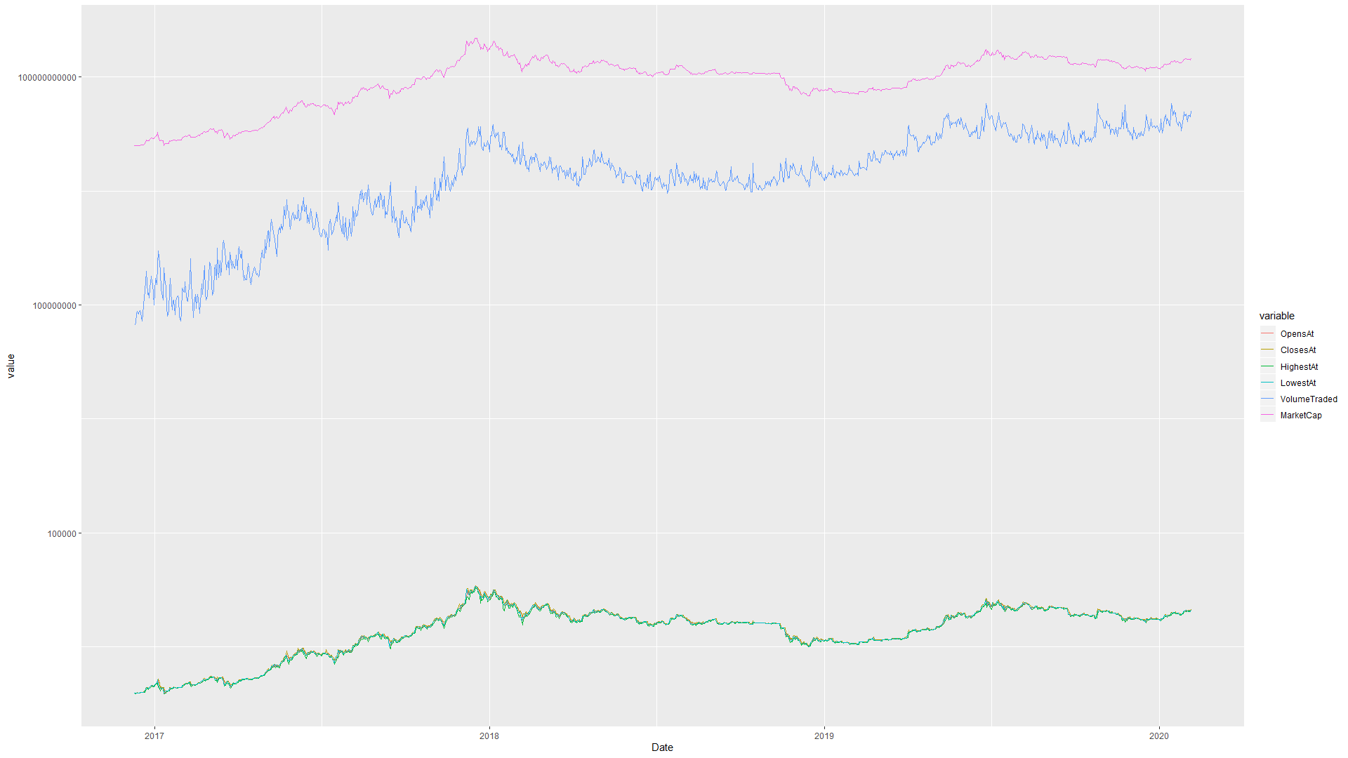
Hugo Joncour - 40139130 Zié Coulibaly - 40046155
Can we predict Tether’s market cap evolution using other cryptocurrencies’s demand ?

Slide 2
Index:
Introduction
Research project
What ?
Why ?
Research project
The data
First results
Research project
Machine Learning Models
Results
Conclusion

Slide 3








Cryptocurrencies

Slide 4
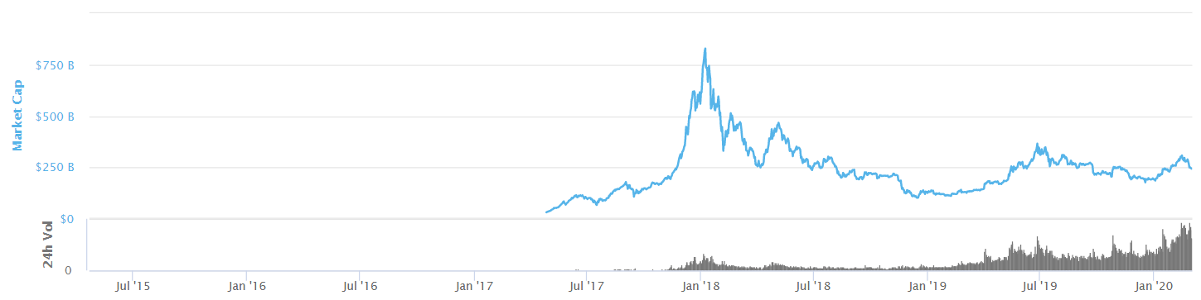
Cryptocurrencies
> 5000 cryptocurrencies
> 20 000 different markets
Volume traded every 24 hours > 125 billion USD
Global Market Cap > 250 billion dollars

Slide 5
Research Project

